Slide 1
Lecture 5

Slide 2
Outline
Introduction
The Public Switched Telephone Network
  PSTN Architecture, Analog Transmission, Digital Transmission of Analog Voice Data, Multiplexing
Circuit Switched Networks
  Topology, POTS, ISDN
Dedicated Circuit Networks
  Topology, T-Carriers, SONET
Packet Switched Networks
  Topology, X.25, ATM, Frame Relay, SMDS, Ethernet/IP Packet Networks
Virtual Private Networks
  Topology, VPN Types

Slide 3
Switching Networks
Long distance transmission is typically done over a network of switched nodes
Nodes not concerned with content of data
End devices are stations
  Computer, terminal, phone, etc.
A collection of nodes and connections is a communications network
Data routed by being switched from node to node

Slide 4
Nodes
Nodes may connect to other nodes only, or to stations and other nodes
Node to node links usually multiplexed
Network is usually partially connected
  Some redundant connections are desirable for reliability
Two different switching technologies
  Circuit switching
  Packet switching

Slide 5
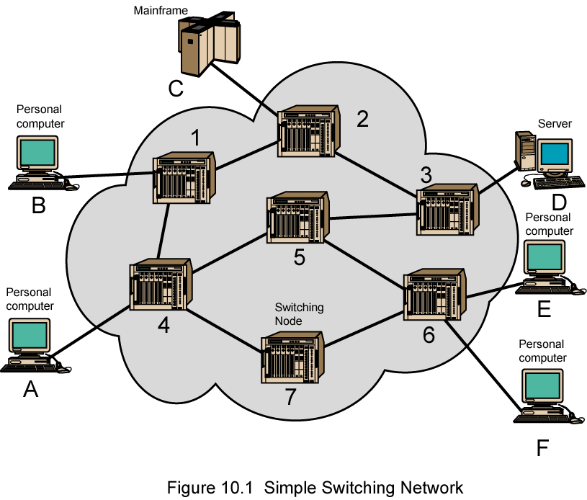
Simple Switched Network

Slide 6
Circuit Switching
Dedicated communication path between two stations
Three phases
  Establish
  Transfer
  Disconnect
Must have switching capacity and channel capacity to establish connection
Must have intelligence to work out routing

Slide 7
Circuit Switching - Applications
Inefficient
  Channel capacity dedicated for duration of connection
  If no data, capacity wasted
Set up (connection) takes time
Once connected, transfer is transparent
Developed for voice traffic (phone)

Slide 8
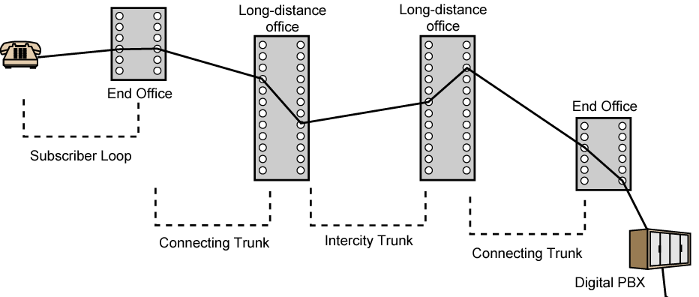
Public Circuit Switched Network

Slide 9
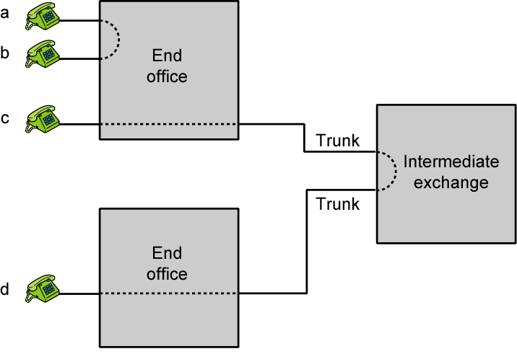
Circuit Establishment

Slide 10
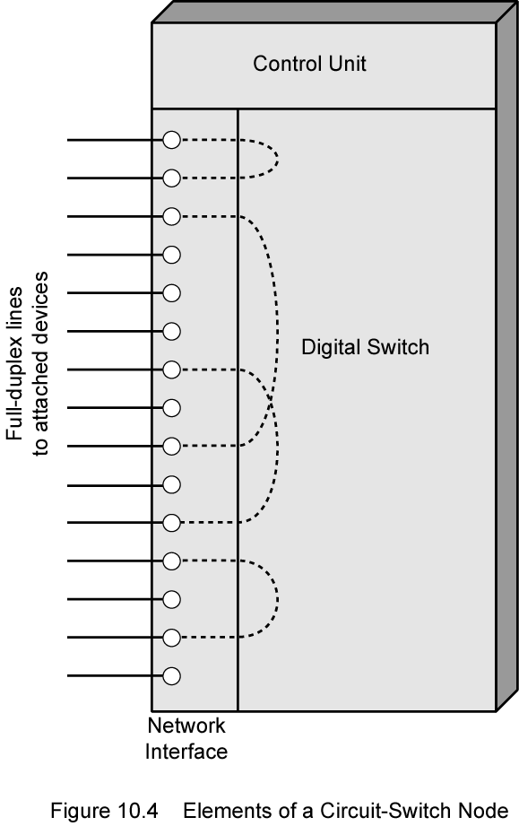
Circuit Switch Elements

Slide 11
Circuit Switching Concepts
Digital Switch
  Provide transparent signal path between devices
Network Interface
Control Unit
  Establish connections
    Generally on demand
    Handle and acknowledge requests
    Determine if destination is free
    construct path
  Maintain connection
  Disconnect

Slide 12
The Public Switched Telephone Network
A Public Switched Telephone Network, or PSTN for short, refers to a telecommunications network which allows subscribers at different sites to communicate by voice. The term Plain Old Telephone Service (POTS) is also frequently used. The features of a PSTN are:
  Subscribers can be connected by entering telephone numbers
  The existing connections are primarily used to transmit speech information
  After hanging up the connection is closed, and the resources used become available to other subscribers

Slide 13
The Telephone Network
Many countries have government agencies that regulate data and voice communications.
The United States agency is the Federal Communications Commission (FCC) and in Tanzania (TCRA)
Each US state also has its own public utilities commission (PUC) to regulate communications within its borders.
A common carriers are private companies that sell or lease communications services and facilities to the public.
Those providing local telephone services are called local exchange carriers (LECs), while those providing long distance services are called interexchange carriers (IXCs).
As telecommunications services are being deregulated, the differences between these two are disappearing.

Slide 14
PSTN Architecture (Figure 5-1)
Unlike LANs and other data networks, the PSTN is circuit switched.
During the set up portion of a telephone call, a special circuit is created, which is then torn down when the call is completed.
Originally, the entire telephone network was analog, but it is now mostly digital.
The digital parts include the switches and backbone lines between them (called trunk lines).
The connection between the customer premises equipment and the first telephone switch, called the local loop, is still analog.

Slide 15
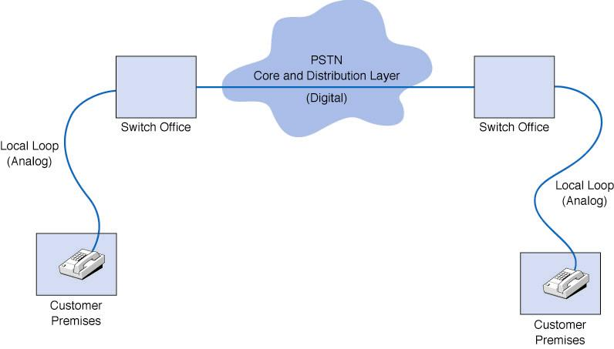
Figure 5-1 Public switched telephone network

Slide 16
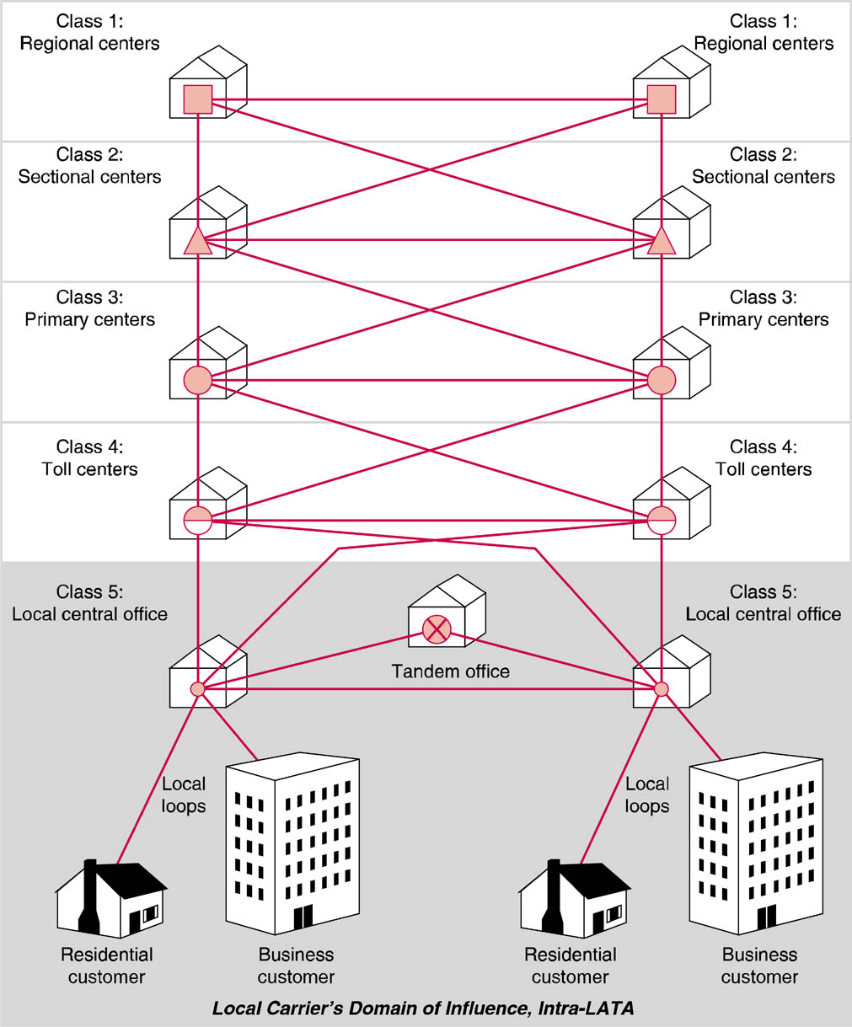
PSTN Network Hierarchy

Slide 17
PSTN Network Hierarchy
Original AT&T system was organized in a 5 class hierarchy – still a standard.
Local CO is lowest level
Regional center is highest level

Slide 18
Digital Transmission of Analog Voice
The analog voice signal created by the sender’s telephone is converted a digital signal using a codec (coder/decoder).
A second codec later converts the digital signal back to an analog one at the receiver’s end.
The codec converts the incoming analog signal to a digital signal by taking repeated samples of the analog signal (see Figure 5-2).
Each sample is then rounded off to a whole number and then encoded as a binary number.
The resulting stream of binary values is sent as a digital transmission over the telephone network.

Slide 19
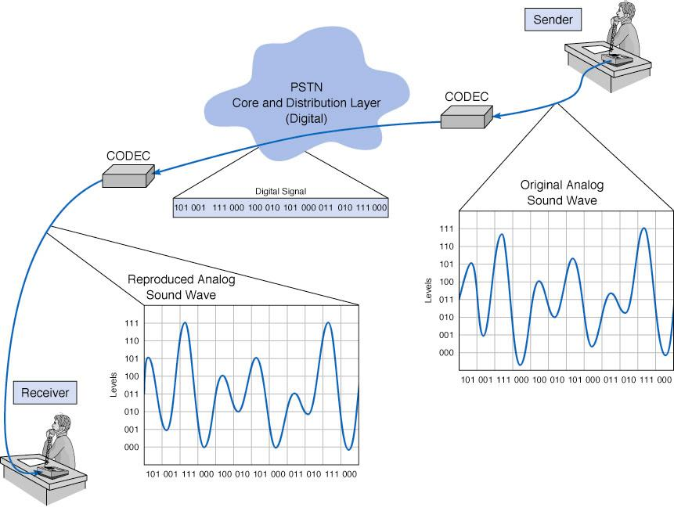
Figure 5-2 Pulse amplitude modulation (PAM)

Slide 20
How Telephones Transmit Voice
The telephone network uses a digitization technique called Pulse Code Modulation (PCM).
PCM samples the incoming analog signal 8000 samples/second using 8 bit samples.
The resulting 64,000 bits per second signal, called a DS-0, that is used throughout the telephone network to send digital transmissions of voice transmissions.

Slide 21
How Instant Messenger Transmits Voice
Instead of PCM, Instant Messaging uses an alternative technique called ADPCM, adaptive differential pulse code modulation.
ADPCM encodes the differences between samples. Instead of 8 bits/sample, ADPCM uses only 4 bits/sample, generally at 8000 samples/second. This allows a voice signal to be sent at 32 kbps, which makes it possible to for IM to send voice signals as digital signals using POTS-based analog phone lines.
ADPCM can sample at lower rates of 8 or 16 kbps, but these produce lower quality voice signals.

Slide 22
Multiplexing
Multiplexing combining several lower speed circuits into a higher speed one.
The advantage to is that multiplexing is cheaper since fewer network circuits are needed.
Inverse Multiplexing, is works in the opposite way, and breaks up a higher speed circuit into two or more lower speed ones (see Figure 5-3).
There are four categories of multiplexing:
  Frequency division multiplexing (FDM)
  Time division multiplexing (TDM)
  Statistical time division multiplexing (STDM)
  Wavelength division multiplexing (WDM)

Slide 23
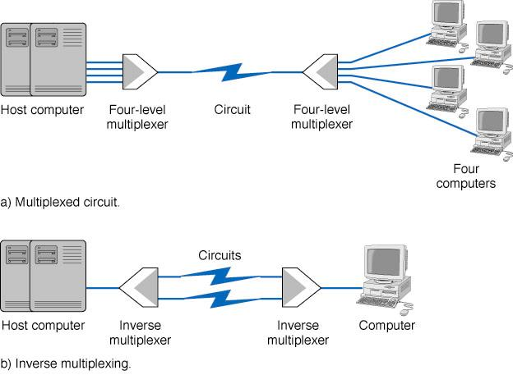
Figure 5-3 Multiplexed circuit and inverse multiplexing

Slide 24
Frequency Division Multiplexing (FDM)
FDM works by making a number of smaller channels from a larger frequency band. FDM is sometimes referred to as dividing the circuit “horizontally”. (see Figure 5-4).
In order to prevent interference between channels, unused frequency bands called guardbands are used to separate the channels. Because of the use of guardbands, there is also significant wasted capacity on an FDM circuit.
CATV uses FDM. FDM was also commonly used to multiplex telephone signals before digital transmission became common and is still used on some older transmission lines.

Slide 25
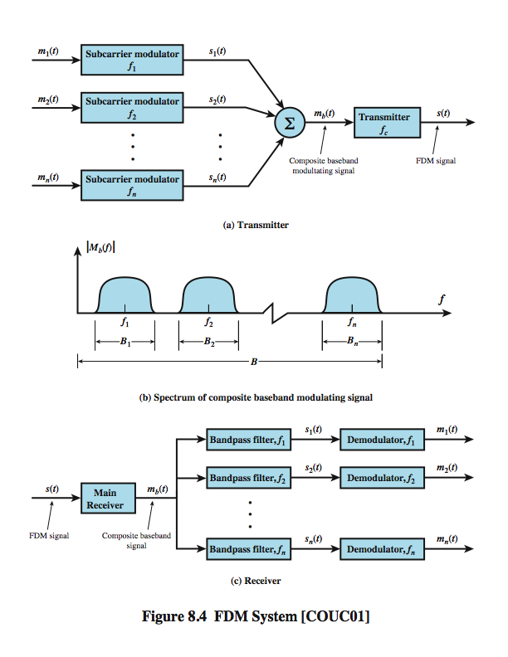
FDM
System Overview
Figure 5-4.
Notes:
A generic depiction of an FDM system is shown in Stallings DCC8e Figure 8.4. A number of analog or digital signals [m_{i}(t), i = 1, n] are to be multiplexed onto the same transmission medium. Modulation equipment is needed to move each signal to the required frequency band, and multiplexing equipment is needed to combine the modulated signals. Each signal m_{i}(t) is modulated onto a carrier f_{i}; because multiple carriers are to be used, each is referred to as a subcarrier. Any type of modulation may be used. The resulting analog, modulated signals are then summed to produce a composite baseband signal m_{b}(t). Figure 8.4b shows the result. The spectrum of signal m_{i}(t) is shifted to be centered on f_{i}. For this scheme to work, f_{i} must be chosen so that the bandwidths of the various signals do not significantly overlap. Otherwise, it will be impossible to recover the original signals. The composite signal may then be shifted as a whole to another carrier frequency by an additional modulation step. The FDM signal s(t) has a total bandwidth B = Sum B_{i} . This analog signal may be transmitted over a suitable medium. At the receiving end, the FDM signal is demodulated to retrieve m_{b}(t), which is then passed through n bandpass filters, each filter centered on f_{i} and having a bandwidth B_{i}, for 1 ≤ i ≤ n. In this way, the signal is again split into its component parts. Each component is then demodulated to recover the original signal.

Slide 26
Time Division Multiplexing (TDM)
TDM allows multiple channels to be used by allowing the channels to send data by taking turns. TDM is sometimes referred to as dividing the circuit “vertically.”
With TDM, time on the circuit is shared equally with each channel getting a specified time slot, whether or not it has any data to send.
TDM is more efficient than FDM, since TDM doesn’t use guardbands, so the entire capacity can be divided up between the data channels.

Slide 27
High-speed digital channel divided into time slots
A₁
A₂
…
t
0T
3T
6T
Framing required
Telephone digital transmission
Digital transmission in backbone network
(a) Each signal transmits 1 unit every 3T seconds
B₁
B₂
…
t
0T
3T
6T
C₁
C₂
…
t
0T
3T
6T
(b) Combined signal transmits 1 unit every T seconds
A₁
B₁
C₁
A₂
B₂
C₂
…
t
0T 1T 2T 3T 4T 5T 6T

Slide 28
Statistical Time Division Multiplexing (STDM)
STDM is designed to make use of the idle time created when terminals are not using the multiplexed circuit.
Like regular TDM, STDM uses time slots, but the time slots are not fixed. Instead, they are used as needed by the different terminals on the multiplexed circuit.
Since the source of a data sample is not identified by the time slot it occupies, additional addressing information must be added to each sample.
If all terminals try to use the multiplexed circuit intensively, response time delays can occur. The multiplexer also needs to contain memory to store data in case more data samples come in than its outgoing circuit capacity can handle.

Slide 29
Wavelength Division Multiplexing (WDM)
With Wavelength Division Multiplexing (WDM), data is transmitted at several different frequencies over the same optical fiber, typical transmitted at 622 Mbps.
A new version of WDM, Dense WDM or DWDM permits up to 40 circuits, with each transmitting at a rate of 10 Gbps, making single fiber aggregate data rates of 400 Gbps possible.
Recently, a new version of DWDM has been announced capable of carrying 128 circuits at 10 Gbps, or an aggregate transmission rates of 1.28 Terabits per second.

Slide 30
Similar to FDM (one-to-one correspondence to frequency), commonly used in optical networks
One fiber line transmits multiple colors
Optical
MUX
Optical
deMUX
λ₁
λ₁
λ₂
λ₁
λ_{2.}
λ₂
λ_{m}
Optical
fiber
λ_{m}
λ_{m}

Slide 31
Code Division Multiplexing (CDM)
Different connections or flows use different codes: orthogonal codes are used
Commonly used in wireless systems: multiple users share the same channel
Notes:
An analogy to the problem of multiple access is a room (channel) in which people wish to talk to each other simultaneously. To avoid confusion, people could take turns speaking (time division), speak at different pitches (frequency/wavelength division), or speak in different languages (code division). Orthogonal codes have a cross-correlation equal to zero; in other words, they do not interfere with each other.

Slide 32
Circuit-Switched Networks
The oldest and simplest MAN/WAN approach.
Circuits provided by common carriers like AT&T and Ameritech using the PSTN.
An example of a switched circuit is using a modem to dial-up and connect to an ISP.
Two basic types in use today are: POTS and ISDN.

Slide 33
Circuit-Switched Network Topology
Uses a cloud architecture, meaning that users connect to a network and what happens inside of the network “cloud” is hidden from the user (see Figure 5-5).
A user using a computer and a modem dials the number of a another computer and creates a temporary circuit between the two.
When the communications session is completed, the circuit is disconnected.

Slide 34
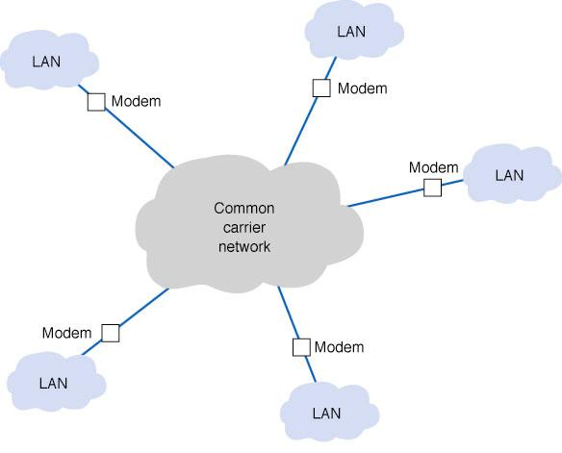
Figure 5-5 Circuit-switched service

Slide 35
Advantages and Disadvantages of Circuit-Switched Networking
The advantages of circuit switched networks are that they are simple, flexible, and inexpensive when not used extensively.
There are two main problems with dialed circuits.
  Each connection goes through the regular telephone network on a different circuit, which vary in quality.
  Data transmission rates are low, from 28.8 to 56 Kbps.
An alternative is to use a private dedicated circuit, which is leased from a common carrier for the user’s exclusive use 24 hrs/day, 7 days/week.

Slide 36
Plain Old Telephone Service (POTS)
POTS-based data communications just uses regular dial-up phone lines and a modem.
The modem is used to call another modem. Once a connection is made, data transfer can begin.
POTS is most commonly used today to connect to the Internet by calling an ISP’s access point.
The most commonly used data link layer protocol for POTS is Point-to-Point Protocol (PPP) developed in the early 1990s for data transfer over a POTS line.

Slide 37
Point-to-Point Protocol (PPP)
PPP uses a half duplex stop media access control protocol.
The modem waits for the other modem to stop transmitting before trying to transmit itself.
Continuous ARQ is the error control method.
Frame structure (see Figure 5-6):
  The frame begins and ends with a flag (01111110)
  The address and control fields are fixed
  The protocol field specifies the network layer protocol (e.g., IP, IPX)
  The message field can be up to 1,500 bytes in length
  CRC-16 is used for the error detection value

Slide 38
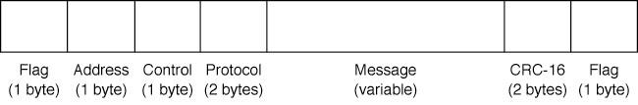
Figure 5-6 Point-to-Point Protocol (PPP).
CRC = cyclic redundancy check.

Slide 39
Modem Transmission of Data
Modems convert digital data from a computer into analog data for transmission over the analog local loop.
The V-series of modem standards are those approved by the ITU-T standards group.
  V.22, an early standard, had a 2400 bps bit rate
  V.34, one of the robust V standards, includes multiple data rates (up to 28.8 kbps) and a handshaking sequence that tests the circuit and determines the optimum data rate. V.34+ increases the max. to 33.6 kbps

Slide 40
Data Compression
Data compression works by encoding redundancies in the outgoing data stream in a simpler form, then decoding them at the receiving end of the transmission.
The V.42bis and V.44 use Lempel-Ziv compression. Lempel-Ziv encoding compresses creates a dictionary of 2-4 byte patterns, then transmits short codes for those patterns.
The usually results in from 4:1 to 6:1 compression.
With modest errors and reasonable compression, a V.90 modem at 56 kbps can have an effective data rate between 200-300 kbps using V.42bis or V.44.

Slide 41
Integrated Services Digital Network (ISDN)
Narrowband ISDN, combines voice, video, and data over the same digital circuit. Acceptance has been slow due to a lack of standardization and relatively high costs.
ISDN operates over digital dial-up lines that work much like analog lines. An “ISDN modem” is used which transmits digital signals.
Narrowband ISDN offers two types of service:
  Basic rate interface (BRI, basic access service or 2B+D) provides two 64 Kbps bearer ‘B’ channels and one 16 Kbps control signaling ‘D’ channel. One advantage of BRI is it can be installed over existing telephones lines (if less than 3.5 miles).
  Primary rate interface (PRI, primary access service or 23B+D) provides 23 64 Kbps ‘B’ channels and one 64 Kbps ‘D’ channel (basically T-1 service).

Slide 42
Broadband ISDN
Broadband ISDN (B-ISDN) is a circuit-switched service that uses ATM to move data.
B-ISDN is backwardly compatible with ISDN.
Three B-ISDN services are currently offered:
  Full duplex channel at 155.2 Mbps
  Full duplex channel at 622.08 Mbps
  Asymmetrical service with two simplex channels (Upstream: 155.2 Mbps, downstream: 622.08 Mbps)

Slide 43
Dedicated-Circuit Networks (Fig. 5-7)
Dedicated-circuits involve leasing circuits from common carriers to create point to point links between organizational locations.
These points are then connected together using special equipment such as routers and switches.
Dedicated-circuits are billed at a flat fee per month for which the user has unlimited use of the circuit.
Dedicated-circuits therefore require more care in network design than dialed circuits.
The three basic dedicated circuit architectures are ring, star, and mesh architectures.

Slide 44
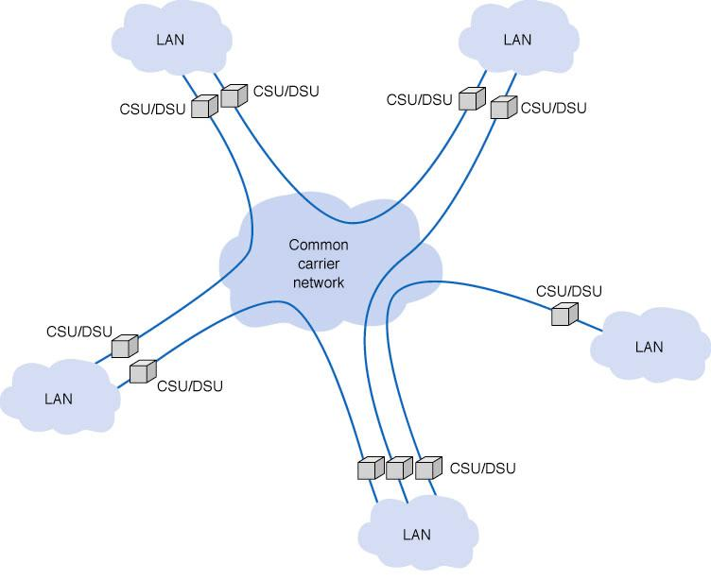
Figure 5-7 Dedicated-circuit services. CSU =
channel service unit; DSU = data service unit

Slide 45
Ring Topology (Figure 5-8)
In a ring topology, computers are in a closed loop, with each computer linked to the next.
Since dedicated circuits are full duplex, data can flow in both directions.
One disadvantage of a ring topology is that messages need to travel through many nodes before reaching their destination.
Failure of any part of the ring does not stop the ring from functioning, since messages can be rerouted around the failed link. This can, however, dramatically reduce network performance.

Slide 46
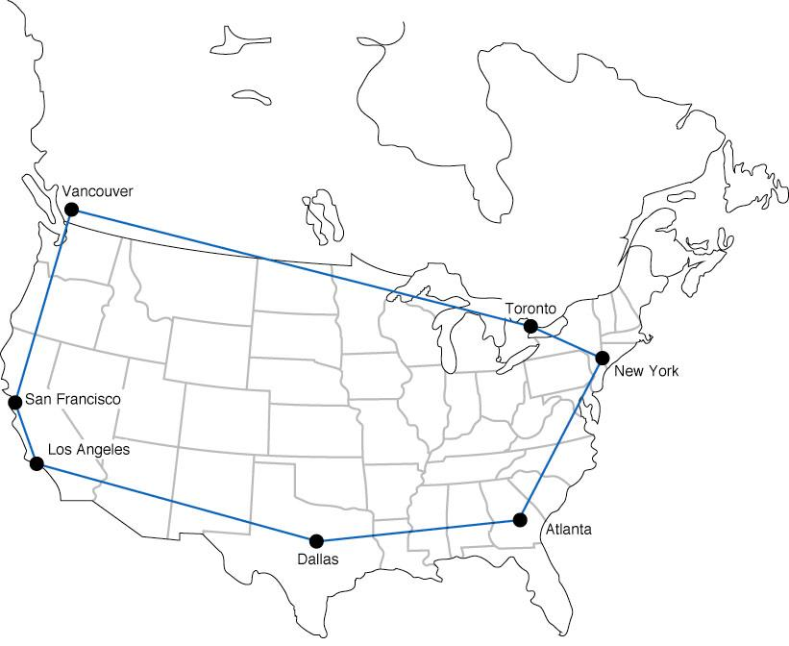
Figure 5-8 Ring-based design

Slide 47
Star Topology (Figure 5-9)
A star-based WAN design connects all computers to a central routing computer that relays messages to their destination, usually using a series of point-to-point dedicated circuits.
The star is easy to manage since the central computer receives and routes all messages in the networks.
The need for the central computer to route all messages means it can also become a bottleneck under high traffic conditions.
The failure of any one circuit or computer generally only affects the computer on that circuit.

Slide 48
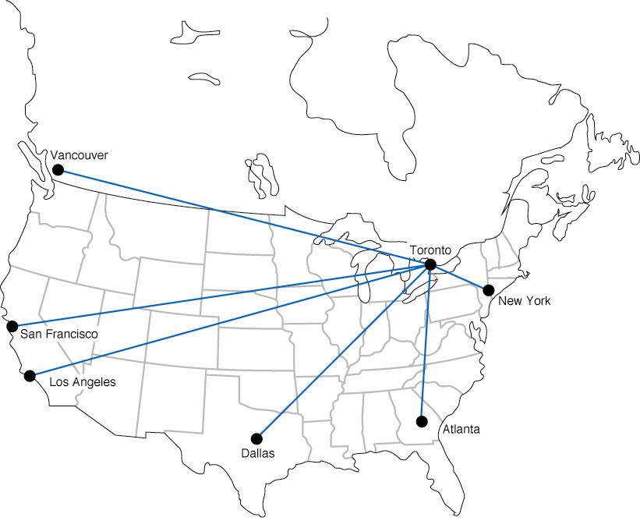
Figure 5-9 Star-based design

Slide 49
Mesh Topology (Figure 5-10)
Mesh architectures can use either a full or partial mesh.
Because creating a full mesh network is so expensive, generally speaking, only partial mesh networks are set up. As long as there are alternative routes on the network, the impact of losing a circuit on the mesh is minimal.
Mesh networks combine the performance benefits of both ring and star networks and use decentralized routing, with each computer performing its own routing.
Setting up the many alternate routes between computers on a mesh network means that creating a mesh architecture is more expensive than setting up a star or ring network.

Slide 50
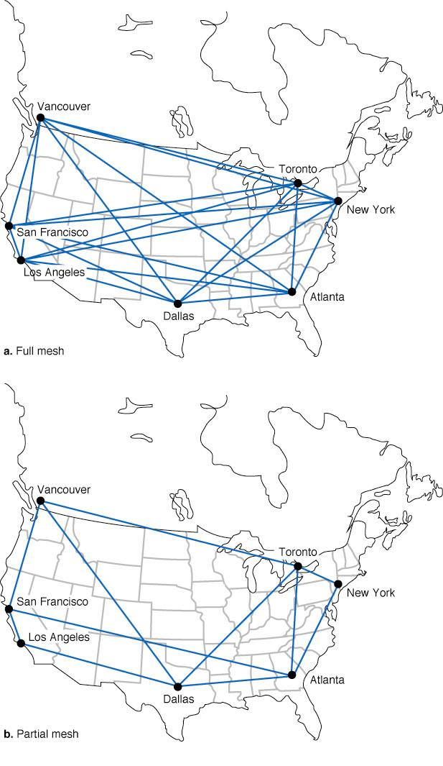
Figure 5-10
Mesh Designs

Slide 51
T-Carrier Services
T-Carrier circuits are the most common dedicated digital circuits used in North America today.
The basic unit of the T-hierarchy is the 64 kbps DS-0 created by digitizing an analog voice channel using PCM.
T-carriers are created by combining a number of DS-0 signals using time division multiplexing along with some overhead information to create a higher speed data stream.

Slide 52
The T-1 Carrier
The lowest level of the T-carrier hierarchy is the T-1, created by combining 24 DS-0 signals.
A T1 multiplexer combines the 8-bit samples from 24 DS-0 channels along with one framing bit to create the 193 bit T1 frame (see Figure 5-11).
This frame is then transmitted 8000 time per second, resulting in a nominal data rate of 193 x 8000 = 1.544 Mbps for a T1 carrier.

Slide 53
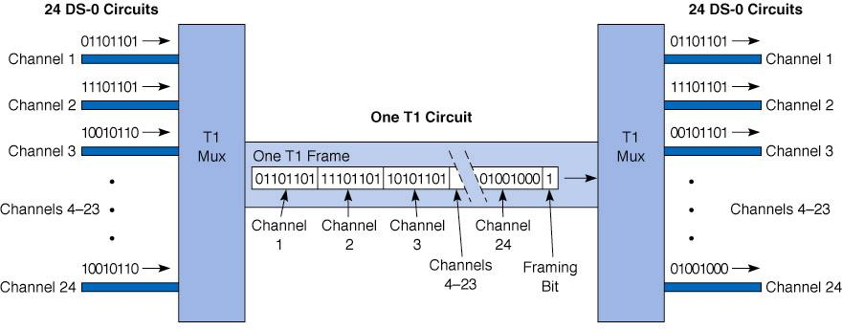
Figure 5-11 T1 data transfer with multiplexing

Slide 54
Inverse Multiplexing with a T-1C Carrier
A T1C circuit is an inverse multiplexed bundle of two T1 circuits.
Each T1C circuit provides a nominal data rate of 3.152 Mbps.
The sending T1C mux transmits the signal by splitting it up between two T1 circuits (see Figure 5-12).
The receiving mux then recombines the incoming data streams from both T1 circuits.

Slide 55
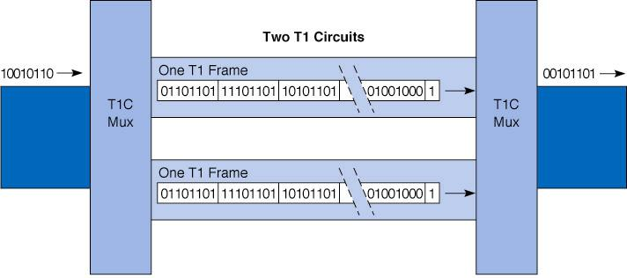
Figure 5-12 T1C data transfer
with inverse multiplexing

Slide 56
The T-Carrier Hierarchy (Figure 5-13)
T-Carrier circuits include:
T-1 circuit (a.k.a. DS-1) has a data rate of 1.544 Mbps. T-1’s allow 24 simultaneous 64 Kbps channels which transport data or voice messages using PCM.
T-2 (6.312 Mbps) multiplexes four T-1 circuits.
T-3 (44.376 Mbps) has a 28 T-1 capacity.
T-4 (274.176 Mbps) has a 178 T-1 capacity.
Fractional T-1, (FT-1) offers a portion of a T-1.

Slide 57
Figure 5-13 Types of T-carrier services
Digital Signal T-Carrier No. of DS-1 Nominal Effective Name Name Channels Data Rate Data Rate
DS-0
DS-1
DS-1C
DS-2
DS-3
DS-4
T-1
T-1C
T-2
T-3
T-4
1
2
4
28
168
64 kbps
1.544 Mbps
3.152 Mbps
6.312 Mbps
33.375 Mbps
274.176 Mbps
53 kbps
1.3 Mbps
2.6 Mbps
5.2 Mbps
36 Mbps
218 Mbps

Slide 58
Figure 5-14 Types of E-carrier services
E-Carrier No. of E-1 Nominal Effective
Name Channels Data Rate Data Rate
E-1
E-2
E-3
E-4
E-5
1
4
16
64
256
2.048 Mbps
8.448 Mbps
34.368 Mbps
139.264 Mbps
565.148 Mbps
1.7 Mbps
6.8 Mbps
27 Mbps
109 Mbps
438 Mbps
(Used in place of T-carriers in Europe, South America,
Africa and most of Asia).

Slide 59
Synchronous Optical Network (SONET)
(Figure 5-15)
The synchronous optical network (SONET) has recently been accepted by ANSI as the standard for optical fiber transmission for speeds in the gigabit per second range.
Optical carrier 1 (OC-1) frames are 810 bytes long and transmitted at 8000 frames/second resulting in a transmission speed of 51.84 Mbps.
Each succeeding SONET hierarchy rate is defined as a multiple of OC-1.
Note that even the lowest member of the SONET hierarchy is faster than a T-3 carrier.

Slide 60
OC Name Number of
OC-1 Channels
Nominal Data Rate
Effective Data Rate
OC-1
OC-3
OC-12
OC-48
OC-192
OC-768
1
3
12
48
192
798
51.84 Mbps
155.52 Mbps
622.08 Mbps
2.488 Gbps
9.953 Gbps
39.812 Gbps
48 Mbps
143 Mbps
571 Mbps
2.3 Gbps
9.1 Gbps
36.4 Gbps
Figure 5-15 Types of SONET services

Slide 61
Packet-Switched Network Topology
Unlike circuit-switched and dedicated-circuit networks, packet-switched networks enable multiple connections to exist simultaneously between computers.
A packet-switched user connects to the network using packet assembly/ disassembly device (PAD) (Fig. 5-16).
Packets may also become interleaved with packets from other messages during transmission.
Organizations usually connect to a packet network by leasing dedicated circuits from their offices to the packet switched network’s point-of-presence (POP).

Slide 62

Figure 5-16 Packet-switched services

Slide 63
Packet Routing Methods
There are two methods for routing packets:
  A datagram is a connectionless service which adds a destination and sequence number to each packet, in addition to information about the data stream to which the packet belongs. Individual packets can follow different routes before being reassembled on the destination host.
  In a virtual circuit the packet switched network establishes an end-to-end circuit between the sender and receiver. All packets for that transmission take the same route over the virtual circuit that has been set up for that transmission.

Slide 64
Permanent and Switched Virtual Circuits
Two types of virtual circuits, permanent (PVCs) and switched (SVC), are available from common carriers. PVCs are far more common.
Although established using software, setting up or taking down a PVC takes days or weeks to do.
Each PVC has two data rates: a committed information rate (CIR), which is guaranteed and a maximum allowable rate (MAR), which sends data only when the extra capacity is available.
Packets sent at rates exceeding the CIR are marked discard eligible (DE), and discarded if the network becomes overloaded, in which case they may need to be retransmitted.

Slide 65
Packet-Switched Service Protocols
There are five protocols in use for packet-switched services:
  X.25
  Asynchronous Transfer Mode (ATM)
  Frame Relay
  Switched Multimegabit Data Service (SMDS)
  Ethernet/IP packet networks

Slide 66
X.25
The oldest packet switched service is X.25, a standard developed by ITU-T.
X.25 offers datagram, switched virtual circuit, and permanent virtual circuit services.
X.25 is a reliable protocol, meaning it performs error control and retransmits bad packets (shown in Figure 5-17).
Although widely used in Europe, X.25 is not in widespread use in North America. The primary reason is the low transmission speed, now 2.048 Mbps (up from 64 Kbps).

Slide 67
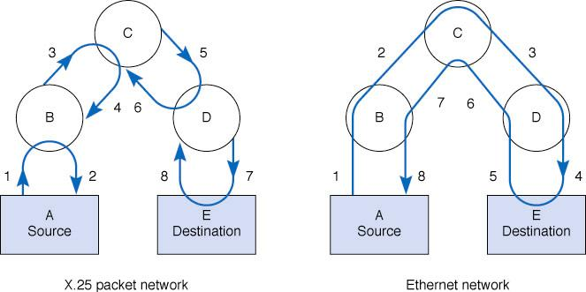
Figure 5-17 Ethernet compared with X.25 packet switching

Slide 68
Asynchronous Transfer Mode (ATM)
Asynchronous transfer mode (ATM) is a newer technology than X. 25
Four differences between ATM and X.25 are:
  ATM performs encapsulation of packets, so they are delivered unchanged across the network.
  ATM is unreliable; i.e., it provides no error control, so error control must be handled at another layer (typically by TCP).
  ATM provides quality of service information enabling priority setting for different transmissions types (e.g., high for voice, lower for e-mail).
  ATM is scaleable, since basic ATM circuits are easily multiplexed onto much faster ones.

Slide 69
Frame Relay
Frame relay is a packet switching technology that transmits data faster than X.25 but slower than ATM.
Like ATM, Frame relay encapsulates packets, so packets are delivered unchanged through the network.
Also like ATM, Frame relay networks are unreliable (although they are capable of doing error checking, this is not enough to make Frame relay reliable).
Common carriers offer frame relay with different transmission speeds: 56 Kbps to 45 Mbps.

Slide 70
Switched Multimegabit Data Service (SMDS)
Switched multimegabit data service (SMDS) is another unreliable packet service like ATM and frame relay.
Most, but not all, RBOCs offer SMDS at a variety of transmission rates, ranging from 56 Kbps up to 45 Mbps.
SMDS is not standardized and offers no clear advantages over frame relay.
For this reason, it is not a widely accepted protocol and offers no advantages over frame relay. Its future is uncertain.

Slide 71
Ethernet/IP Packet Networks
Recently, Internet startups began offering Ethernet/IP services over MAN/WAN networks.
All other MAN/WAN services; X.25, ATM, Frame Relay and SMDS use different protocols from Ethernet, so data must be translated or encapsulated before it is sent over these networks.
Companies offering Ethernet/IP have set up their own gigabit Ethernet fiber optic networks in some large cities, bypassing common carrier networks.
Ethernet/IP packet network services currently offer CIR speeds from 1 Mbps to 1 Gbps at 1/4 the cost of more traditional services.

Slide 72
Virtual Private Networks
Virtual Private Networks (VPNs) use PVCs that run over the Internet but appear to the user as private networks (see Figure 5-18).
Packets sent over these PVCs, called tunnels, are encapsulated using special protocols that also encrypt the IP packets they enclose.
The growing popularity of VPNs is based on their low cost and flexibility.
There are two important disadvantages of VPNs:
  the unpredictability of Internet traffic
  the lack of standards for Internet-based VPNs, so that not all vendor equipment and services are compatible.

Slide 73
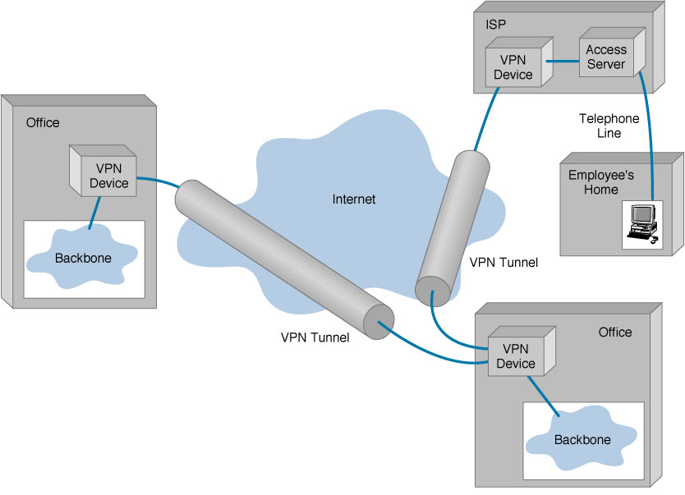
Figure 5-18 A virtual private network (VPN)

Slide 74
Basic VPN Architecture (Figure 5-19)
Each location connected to a VPN is first connected to the ISP providing the VPN service using a leased circuit, such as T-1 line which connects to the ISP’s PVCs at ISP access points.
Outgoing packets from the VPN are sent through specially designed routers or switches.
The sending VPN device encapsulates the outgoing packet with a protocol used to move it through the tunnel to the VPN device on the other side.
The VPN device at the receiver, strips off the VPN packet and delivers the packet to the destination network.
The VPN is transparent to the users, ISP, and the Internet as a whole; it appears to be simply a stream of packets moving across the Internet.

Slide 75
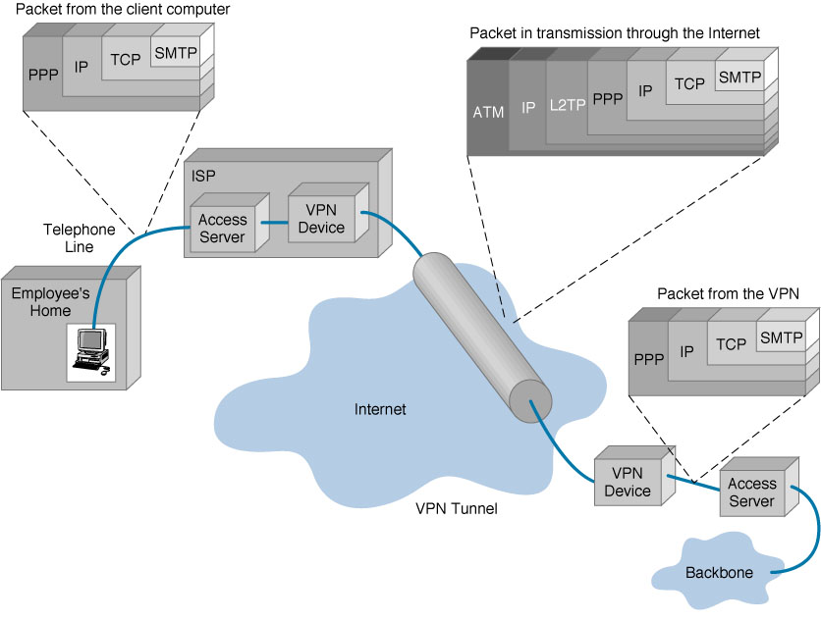
Figure 5-19 VPN encapsulation of packets

Slide 76
VPN Types
Three types of VPN are in common use: intranet VPNs, extranet VPNs and access VPNs.
  An intranet VPN provides virtual circuits between organization offices over the Internet.
  An extranet VPN is the same as an intranet VPN except that the VPN connects several different organizations, e.g., customers and suppliers, over the Internet.
  An access VPN enables employees to access an organization's networks from a remote location.

Slide 77
Thanks

